Slide 1
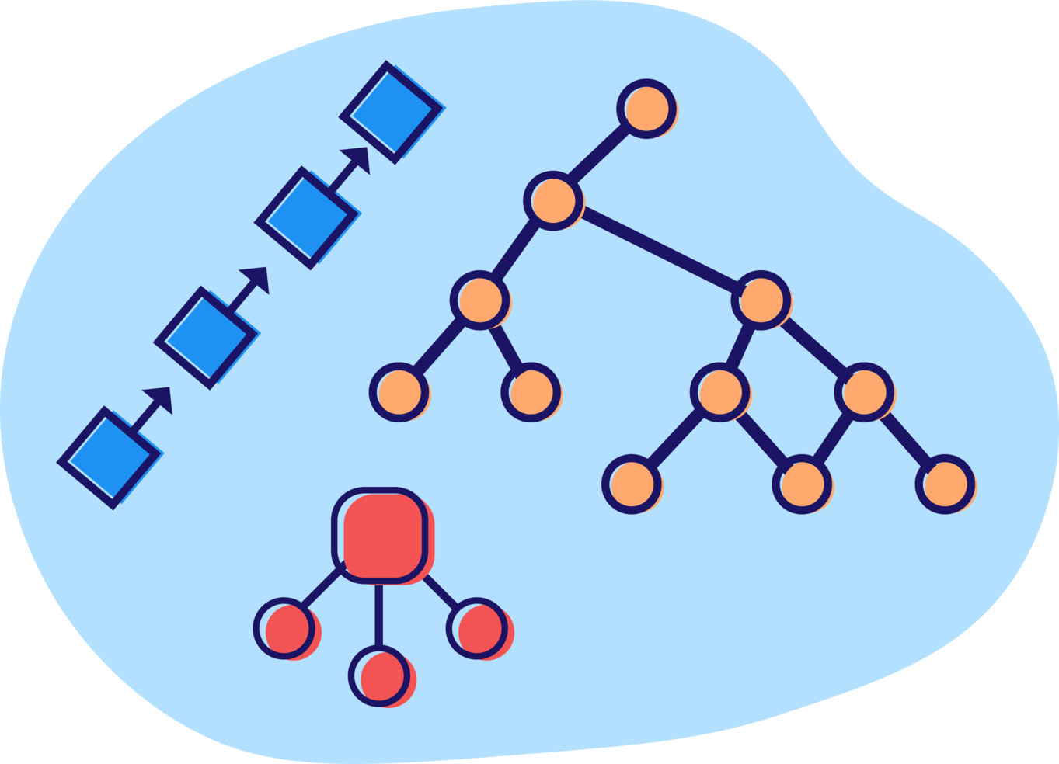
Introduction to Data Structure and Algorithms

Slide 2
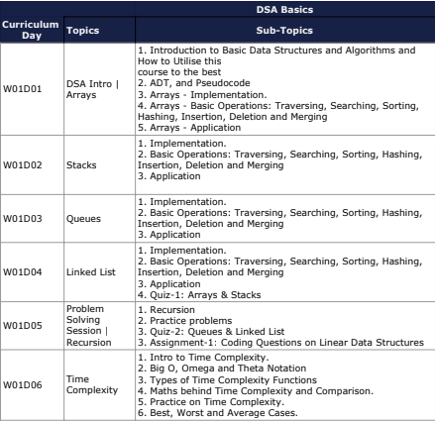
What will we cover

Slide 3
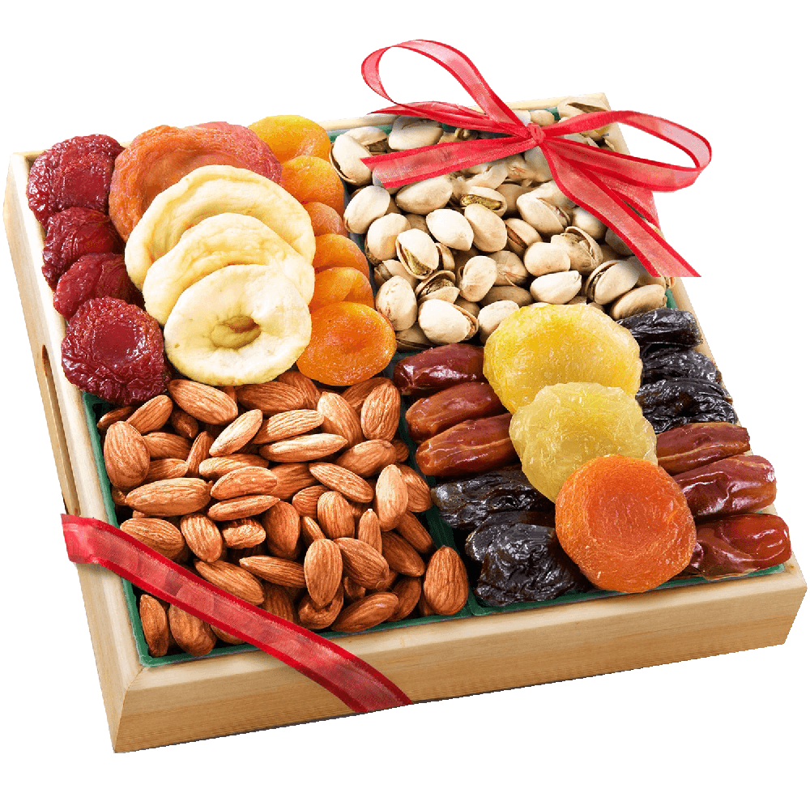
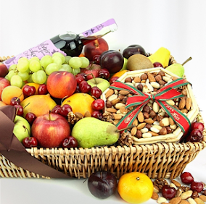
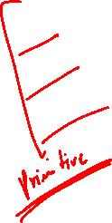
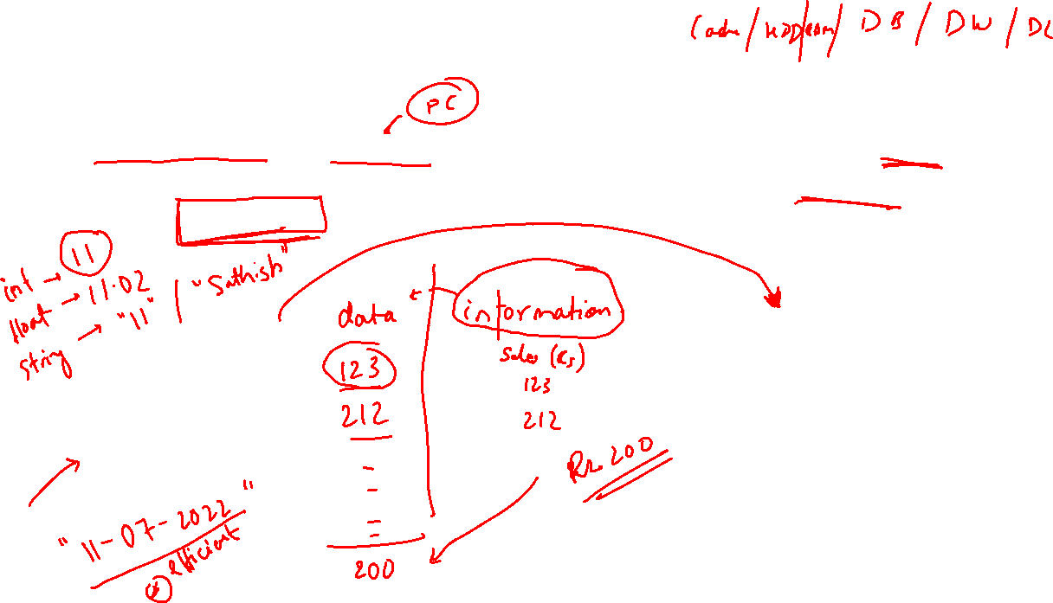
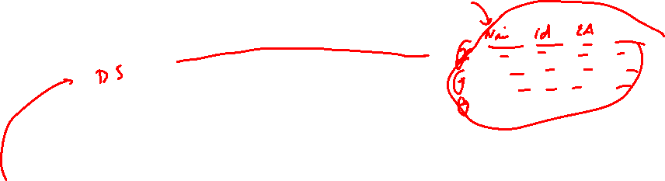
What is Data Structure
A data structure is a storage that is used to store and organize data. It is a way of arranging data on a computer so that it can be accessed and updated efficiently.

Slide 4
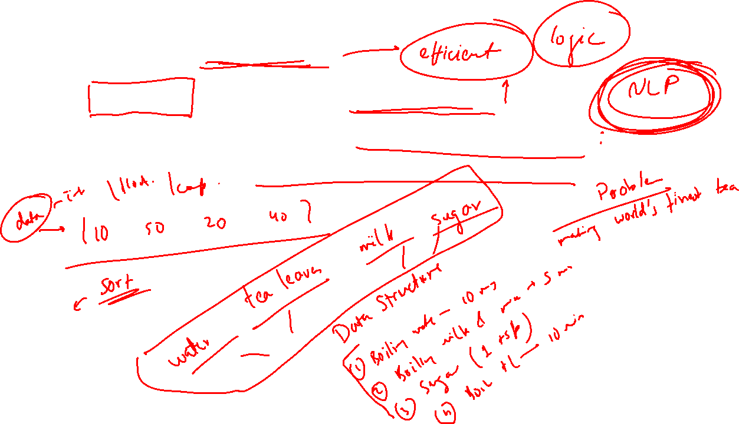

What is an Algorithm
Is a set of rules to be followed to solve a problem.
To solve that problem we will be using some data structure.
Example you want to prepare something from the data.

Slide 5
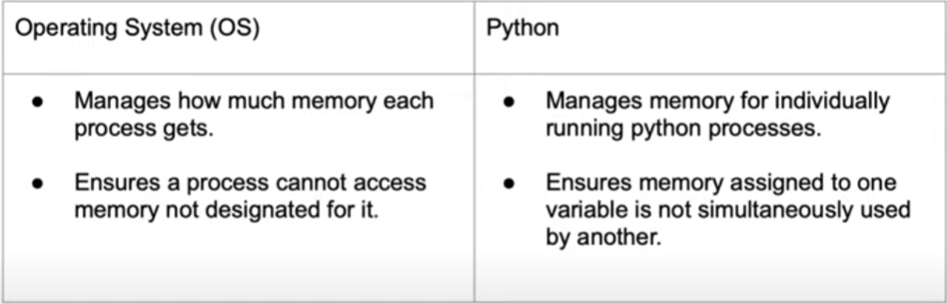
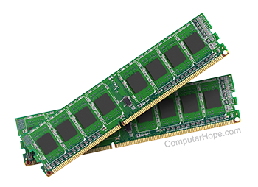
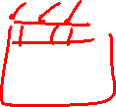
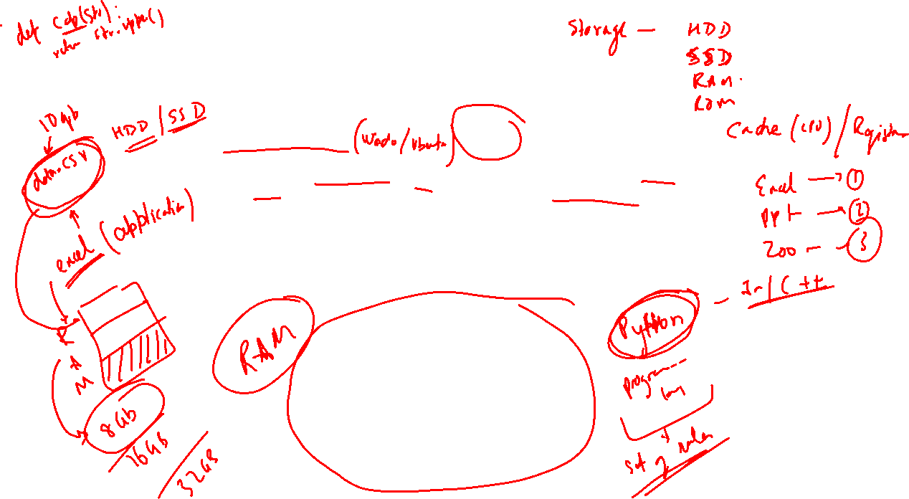
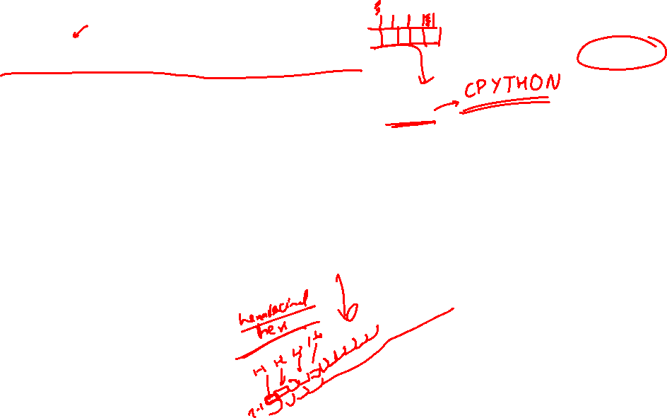
Memory Management

Slide 6

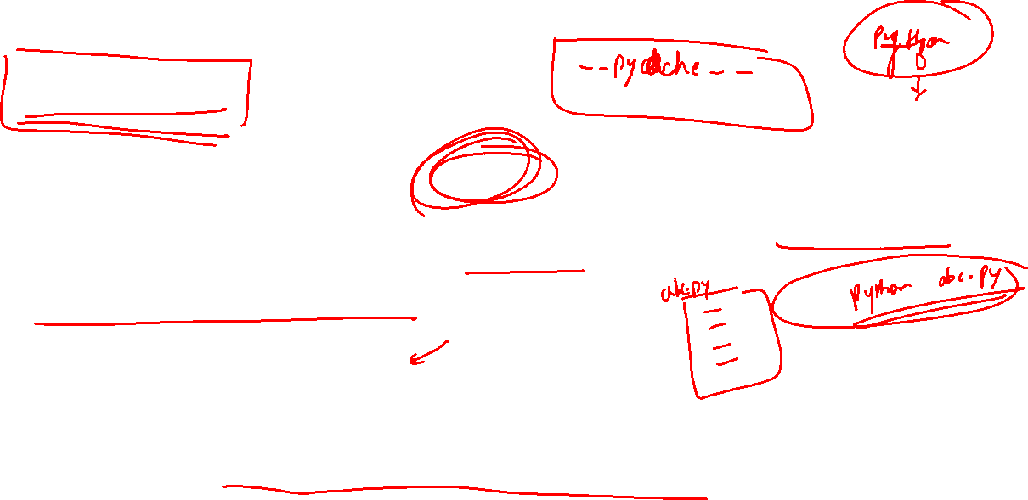
CPython
CPython is the reference implementation of the Python programming language. Written in C and Python, CPython is the default and most widely used implementation of the Python language.
Actually runs your code
Knows all the ‘rules’ of the language
called when running python command at terminal

Slide 7
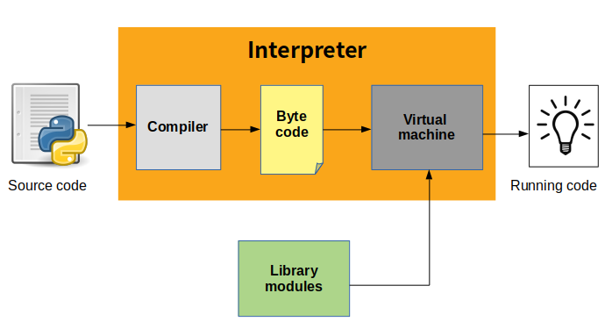
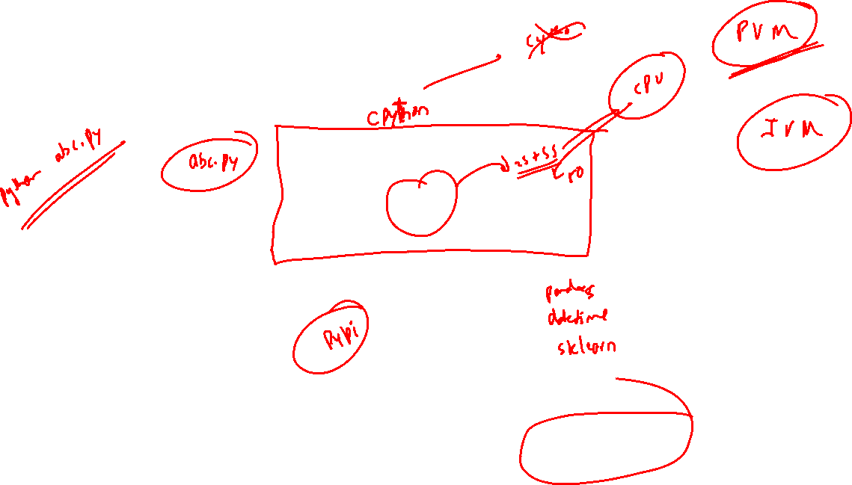
CPython
All the memory management structures and algorithms exist in Cpython Codebase

Slide 8
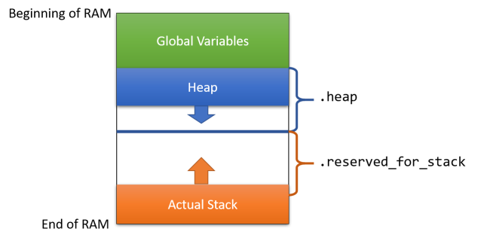

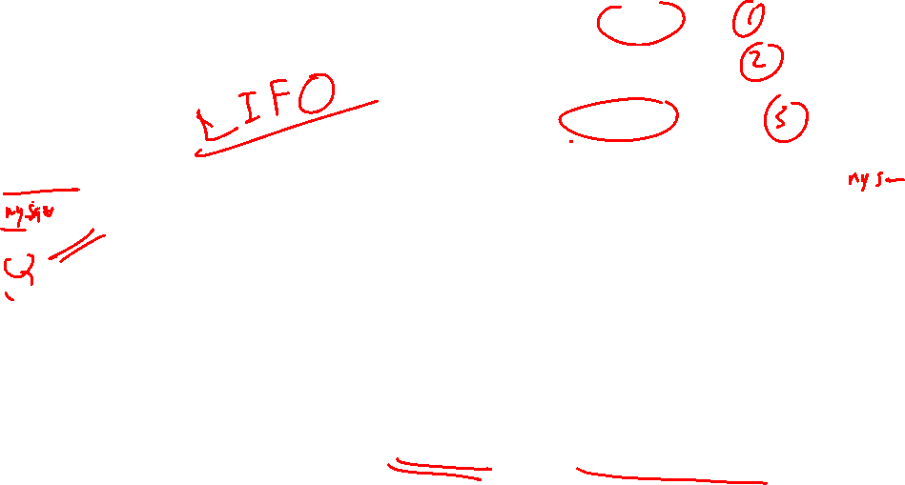
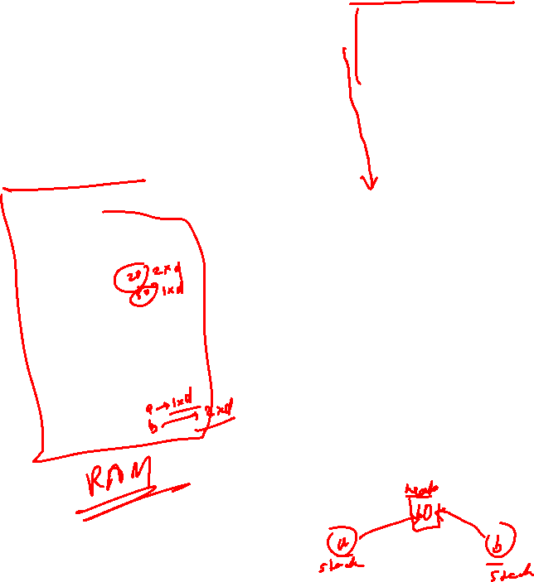
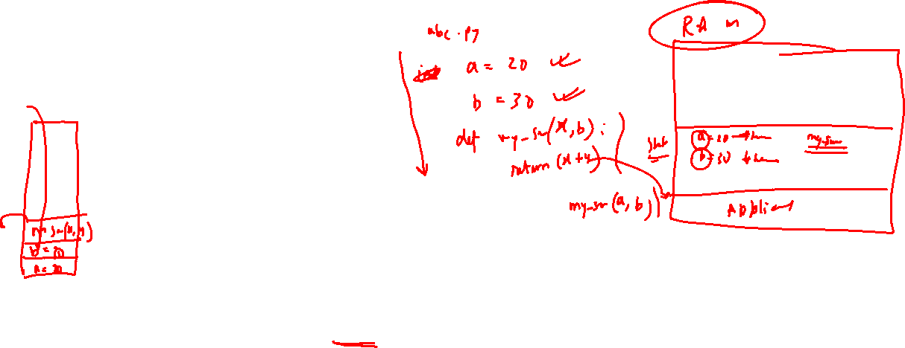
Stack and Heap
Heap holds the object value
values can be access globally
Stack holds the memory location of reference value
Stores the static variable
methods and variables are stored here – stack frame
destroyed automatically when functions and methods are returned

Slide 9
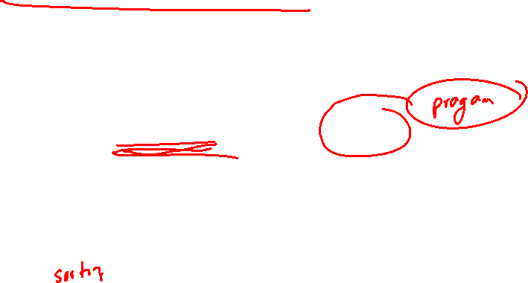
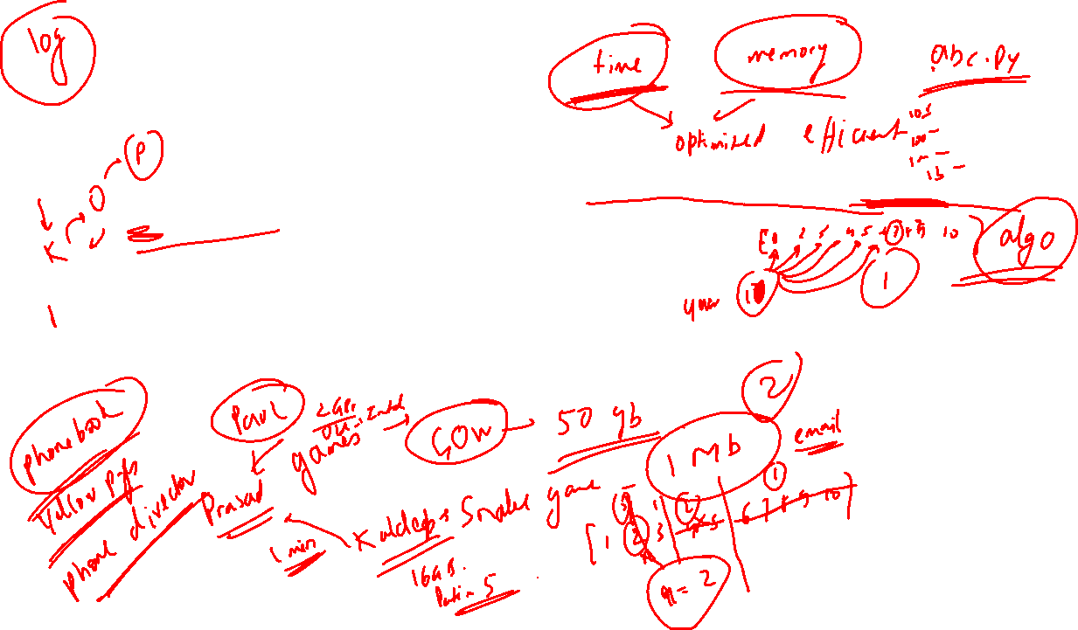
Runtime Analysis
It is a study of runtime of a given algorithm, by identifying its behavior as the input size for the algo increases.
What is the performance of a given algorithm.
Why do we need to measure the performance of the given algorithm? Basically, it tells us if our algo is good enough to give faster response on bigger data.

Slide 10
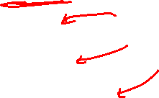
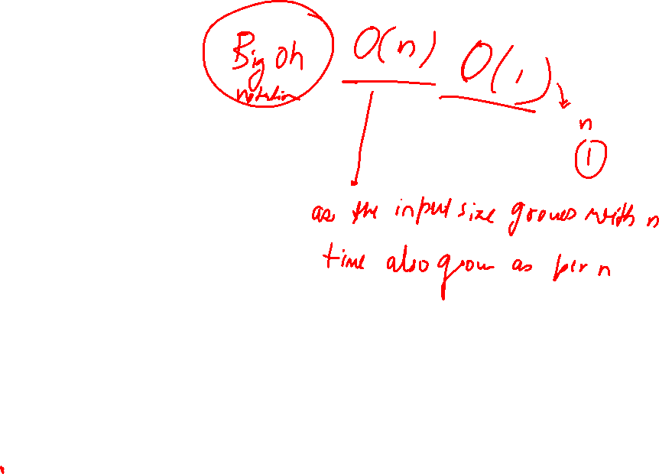
Runtime Analysis
Consider an example of a car/bike, how do one tell about the mileage
Highway -> 20 km/l – Good (Best) City Traffic -> 10 km/l – Poor (Worst) Mixed Environment -> 15 km/l - Average
Similarly algo runtimes may be defined as:
Best Case Scenario – Time Taken Worst Case Scenario – Time Take Average Case Scenario – Time Taken

Slide 11
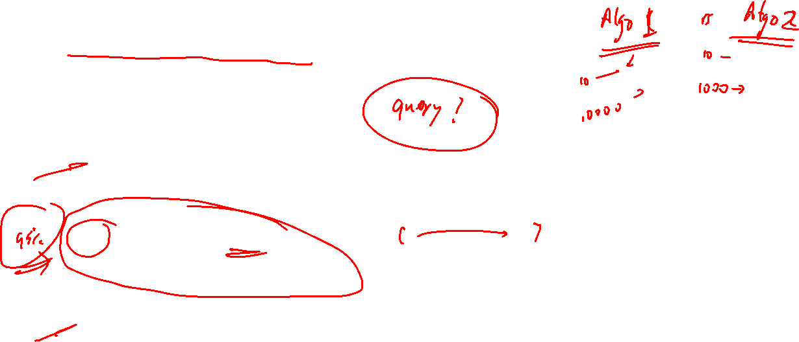
Time Complexity Examples
Say you have to write a program to search a given value in an array
[10, 5, 6, 11, 3,….. 26,……. 20,……… 30]
Omega (Ω) – 10 search – Best case scenario Ω(1)
1 : Always guarantees that minimum time required for executing the algo.
Big O – Worst Case Scenario O(n)
n : Algo will not be more than the given time
Theta (Θ) - Average Case Scenario Θ(n/2)
n/2 : On an average it will take n/2 time on an average

Slide 12
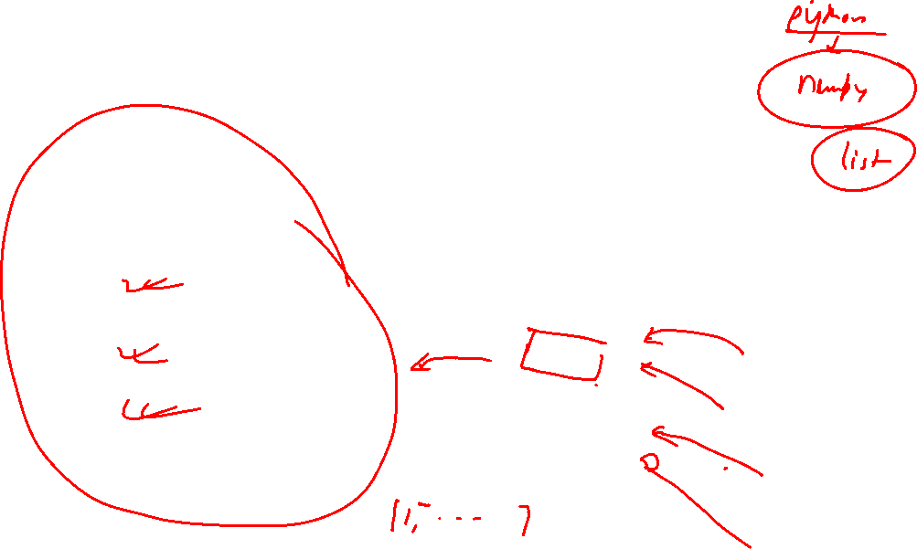
Types of Data Structure (DS)
Types
Primitive
Non-Primitive
Integer
Physical
Logical (ADT)
Float
Array
Stack
Boolean
Linked List
Queue
Tree
Graph

Slide 13
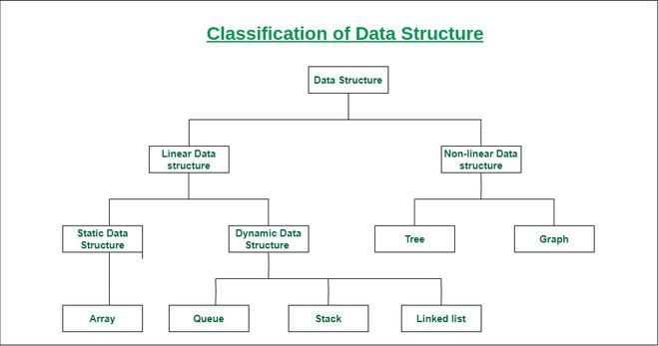
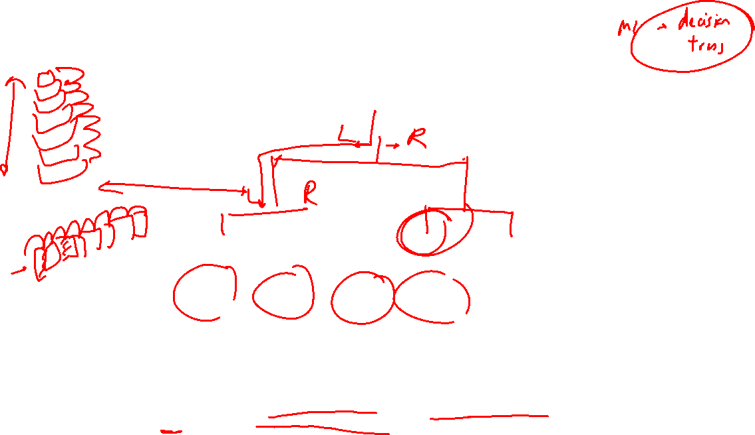
Classification of Data Structure (DS)
Linear Data Structure: Data structure where data elements are arranged sequentially or linearly where the elements are attached to its previous and next adjacent in what is called a linear data structure. In linear data structure, single level is involved. Therefore, we can traverse all the elements in single run only. Linear data structures are easy to implement because computer memory is arranged in a linear way. Its examples are array, stack, queue, linked list, etc.
Non-linear Data Structure: Data structures where data elements are not arranged sequentially or linearly are called non-linear data structures. In a non-linear data structure, single level is not involved. Therefore, we can’t traverse all the elements in single run only. Non-linear data structures are not easy to implement in comparison to linear data structure. It utilizes computer memory efficiently in comparison to a linear data structure. Its examples are trees and graphs.

Slide 14
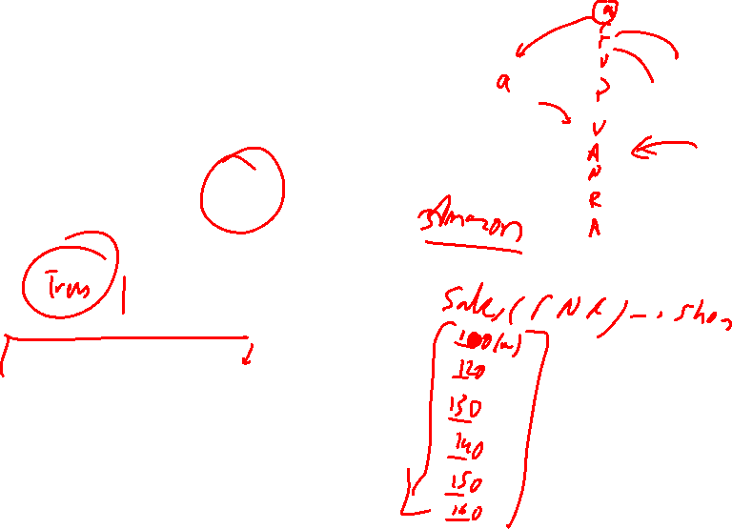
Why so many DS ?

Slide 15
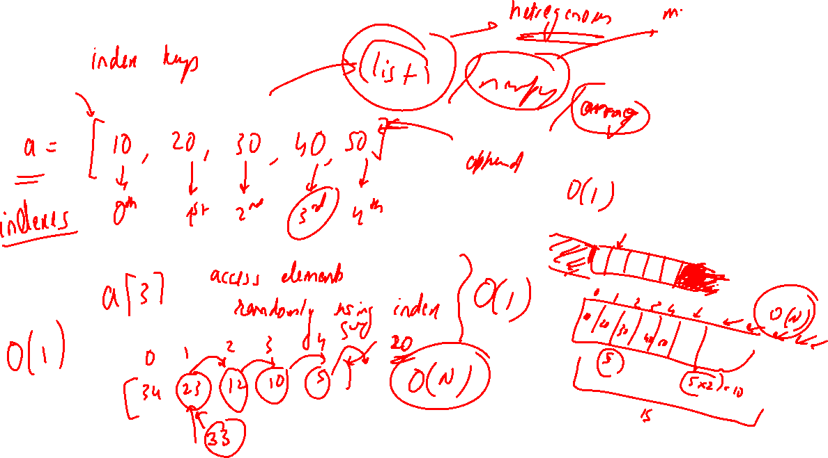
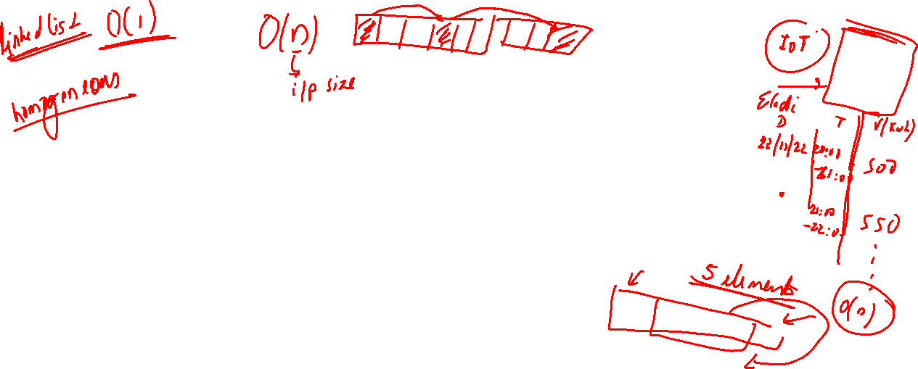

Slide 18
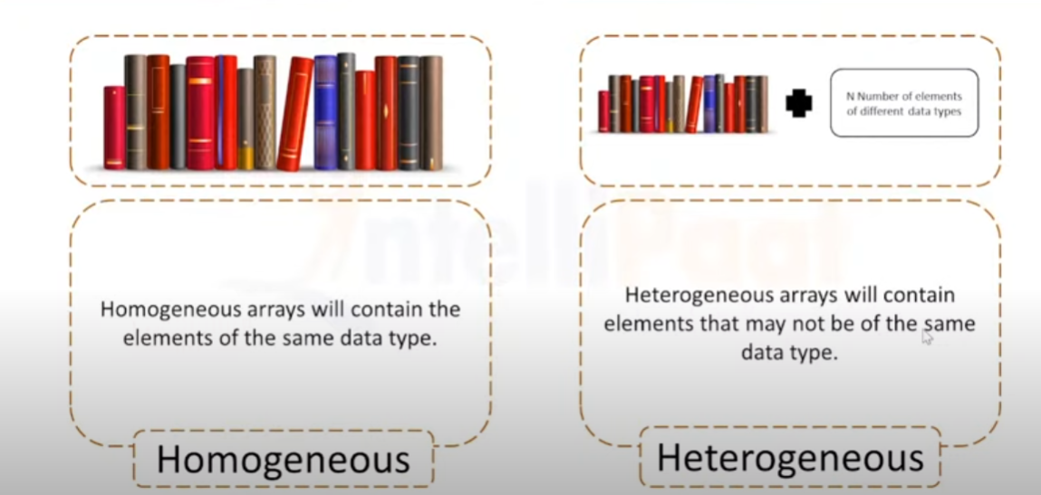
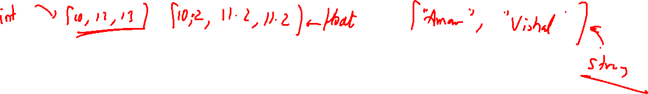
Homogeneous and Non-Homogeneous

Slide 19

What is an Array/List?
Array is a DS consisting of collection of elements each identified by an index. It is stored such that the position of each element can be computed from its index. Because of index : Random Access is possible
For example,
List of Science marks for Class-XII: [89, 78, 95, 92, 91]
List of things to purchase: [“Apples”, “Notebook”, “Highlighters”, “Chocolates”]
In programming languages like Python and JavaScript, arrays are heterogeneous which means you can store different data type values in the same array.
For example,
[“John”, “Wick”, 42, true]

Slide 20
Properties of Array
Array can store values of any single data type. (int, Boolean, float, String)
Every cell of an Array has an unique index.
Index starts with 0.
In programming languages like Python and JavaScript, you do NOT have to specify the length of the array. The length increases when you add more items. The length decreases when you remove items.

Slide 21
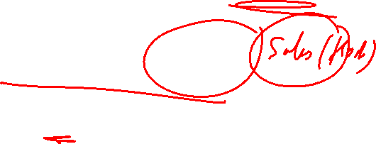
What is the need of an Array?
“We want to store 1 million data of some data types”
How do we maintain such list of variables?
We store it in an array!

Slide 22
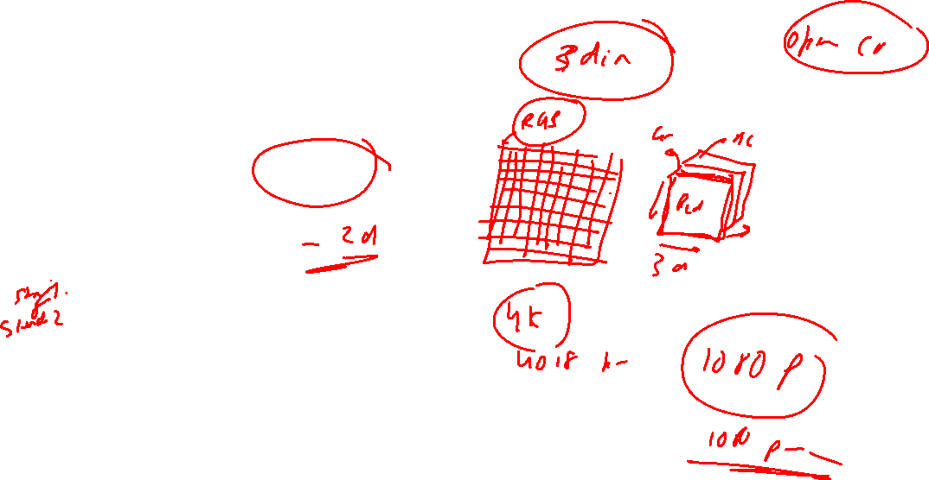
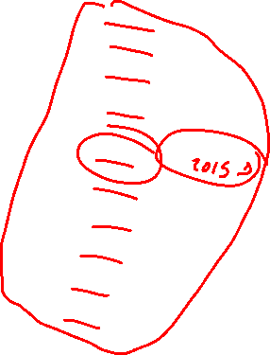
Type of array
1-d array
students roll no – [1, 2, 3]
multiple dimension
students marks
[98, 99, 100]
[89, 96, 78]
student_roll = array(‘i’, [101, 102, 103, 104])
for element in student_roll:
print(element)

Slide 23

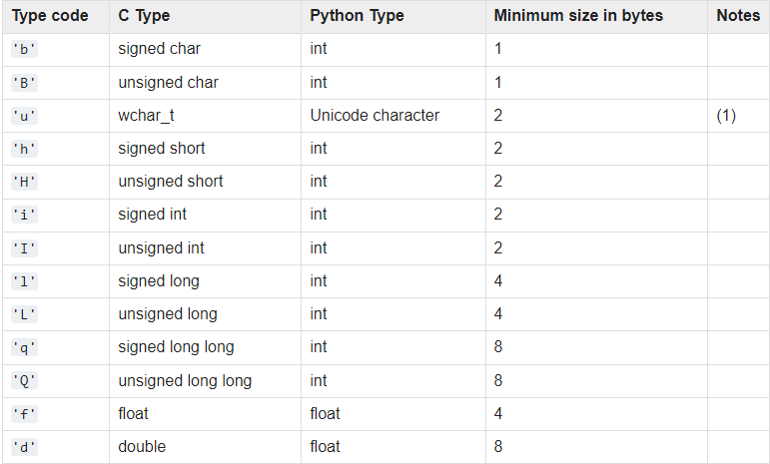
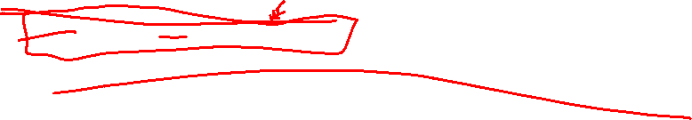
Declaring, Instantiating, Initializing

Slide 24
Traversal of an Array
from array import *
array1 = array('i', [10,20,30,40,50])
for x in array1:
print (x)
Time Complexity : O (n)

Slide 25
Access an Item at Position in an Array
from array import *
array1 = array('i', [10,20,30,40,50])
print (array1[0])
Time Complexity : O(1)

Slide 26
Inserting New Item in an Array
from array import *
array1 = array('i', [10,20,30,40,50])
array1.insert(1,60)
Time Complexity : O(n)

Slide 27
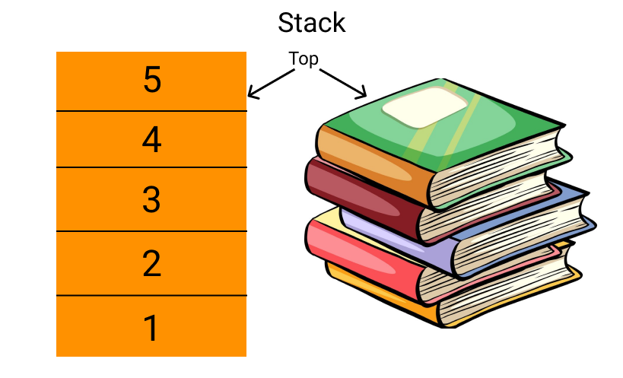
Stack in Python
A stack is a linear data structure that stores items in a Last In First Out way.

Slide 28
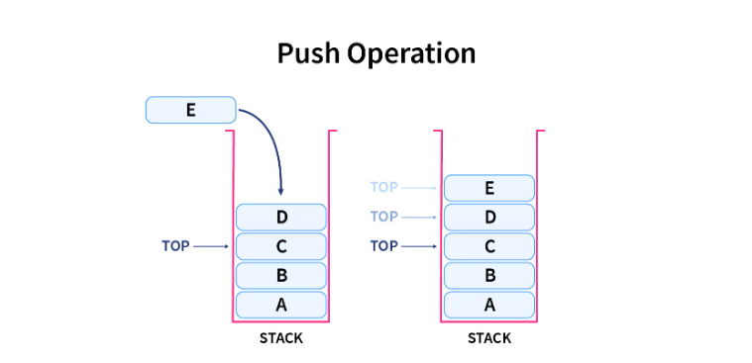
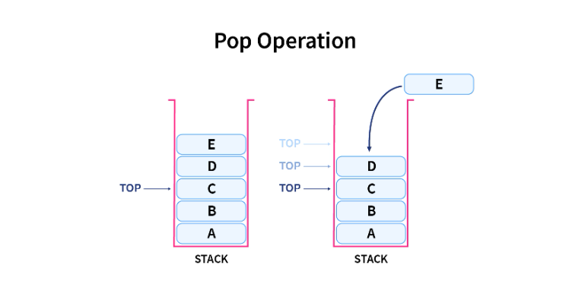
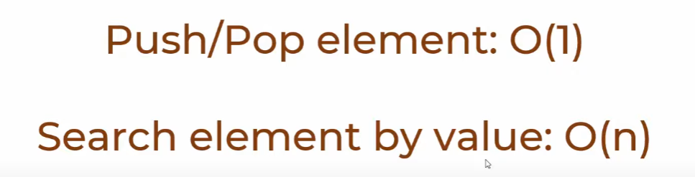
Stack operations
The insert and delete operations performed on the stack are often termed as push (inserting an element) and pop (deleting an element).

Slide 29
Stack in Python Using a List , dequeue

Slide 30
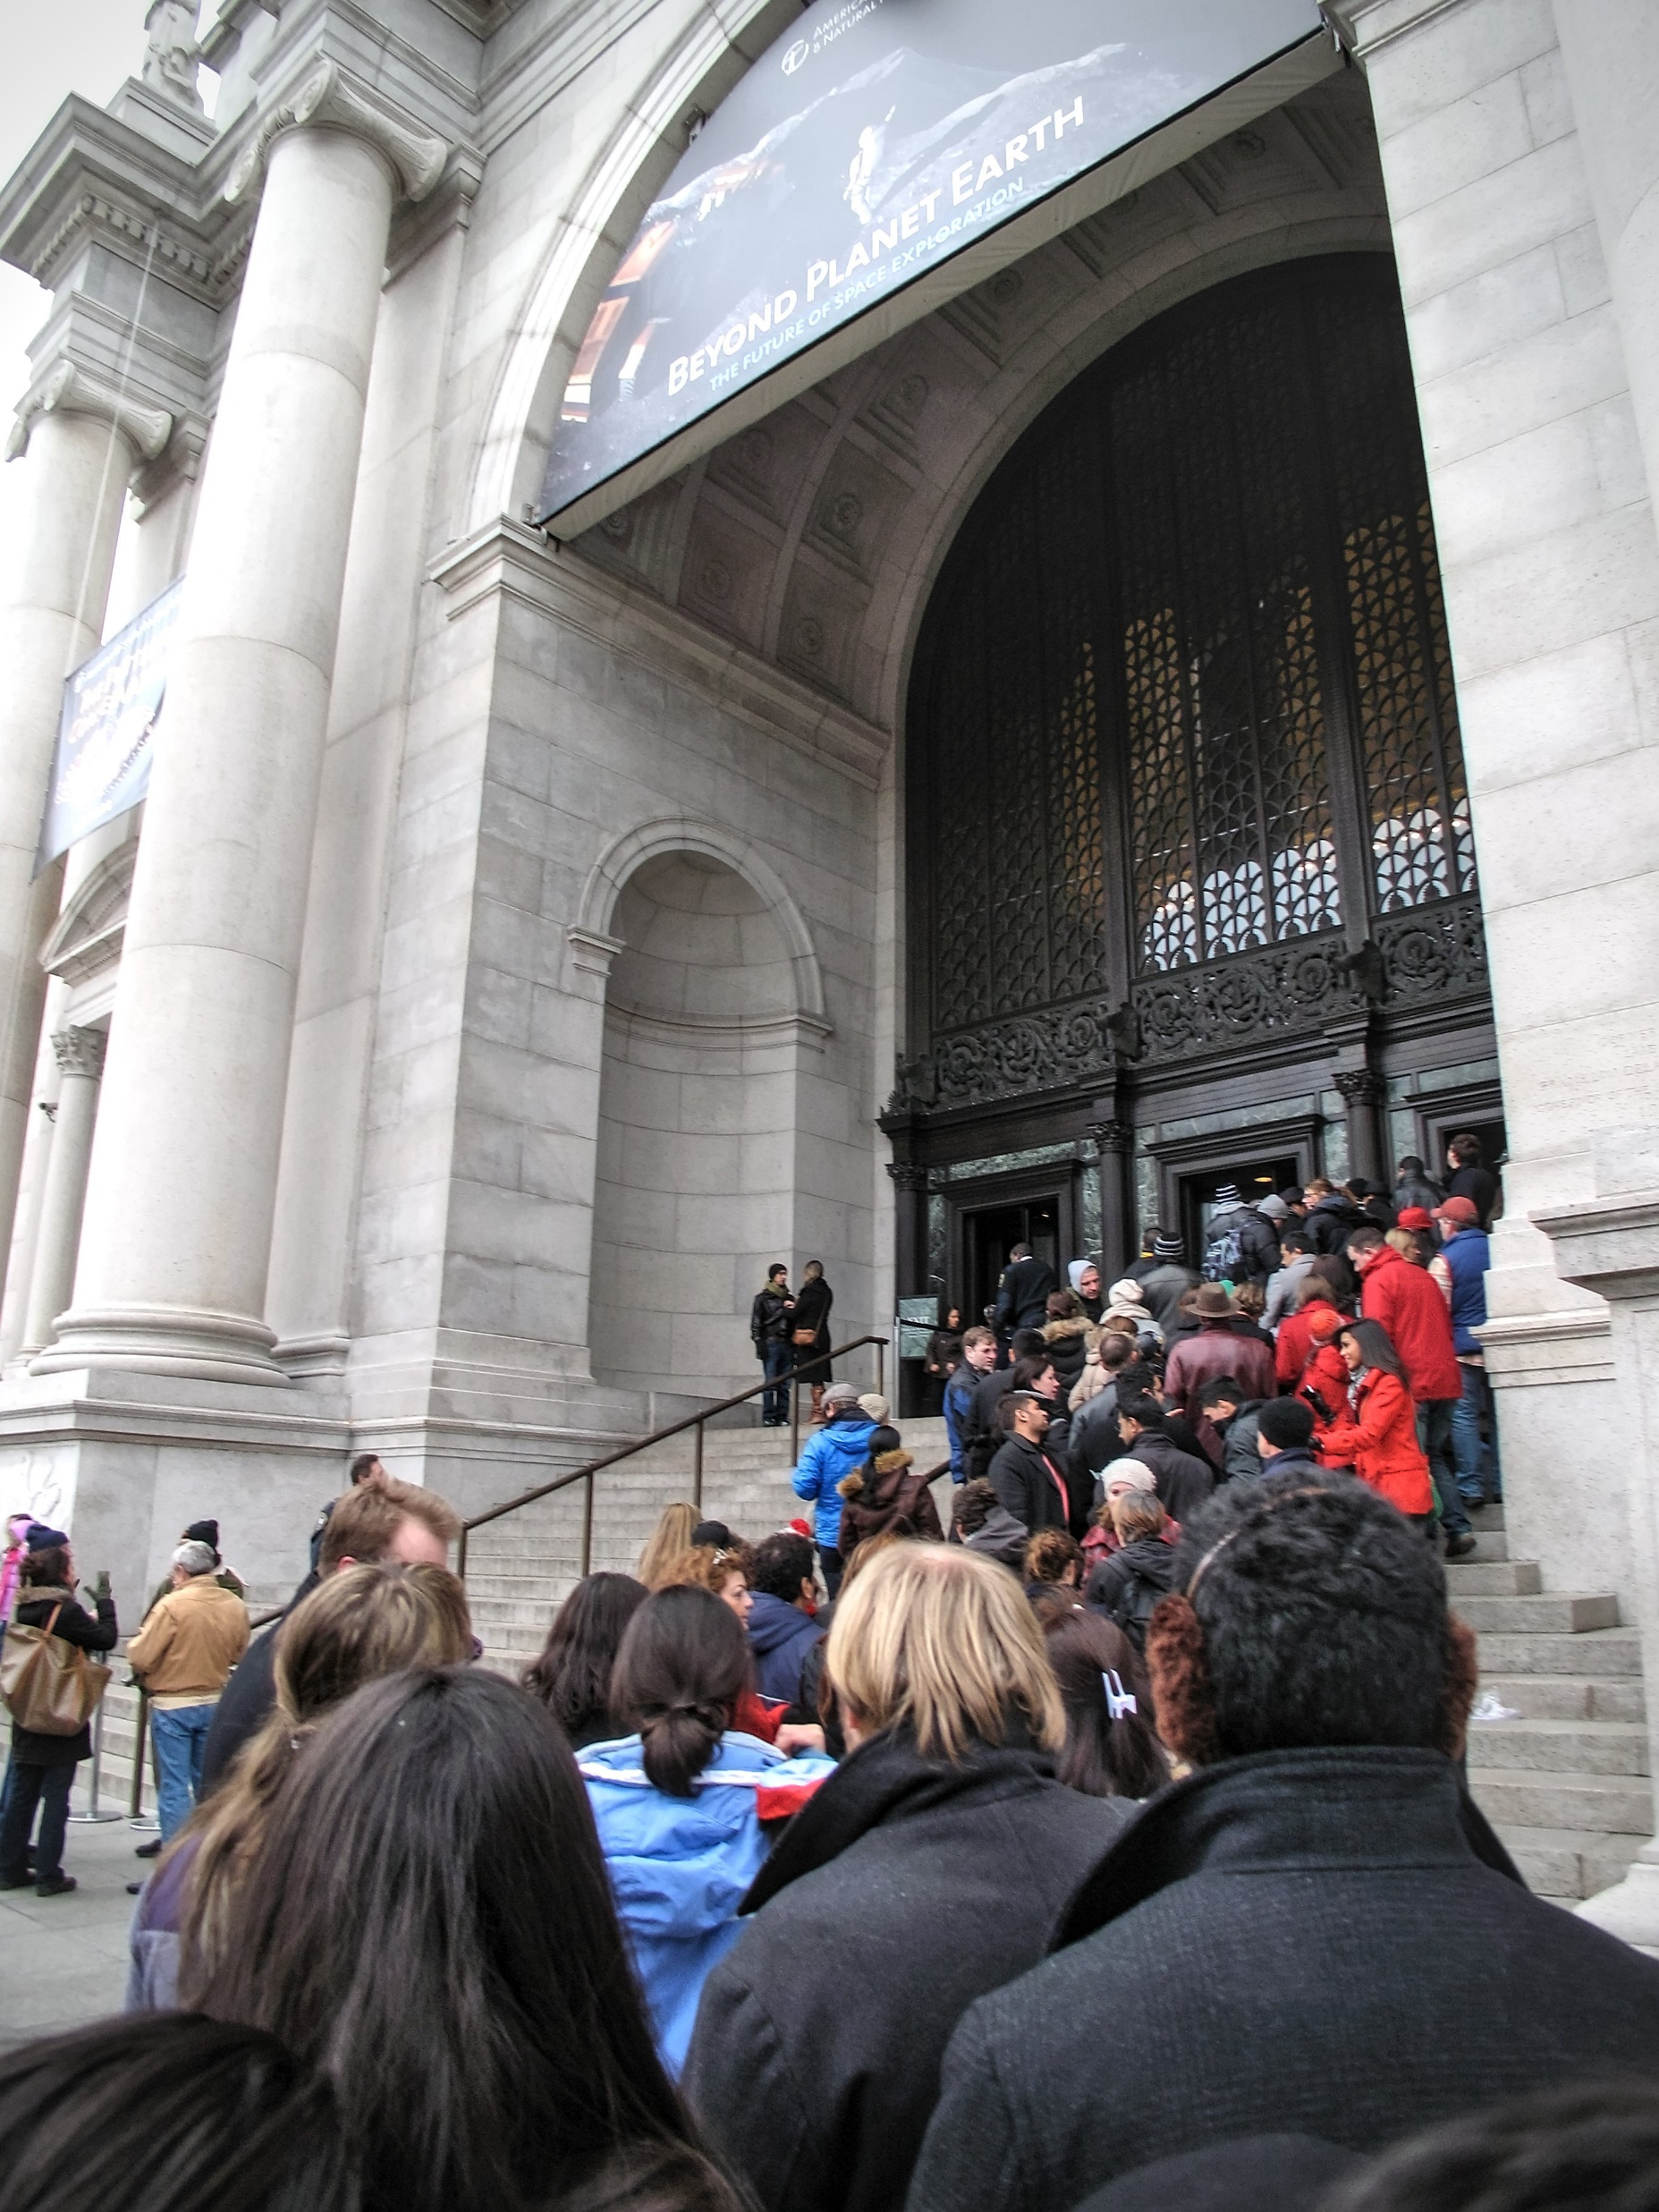
Queue in Python

Slide 31
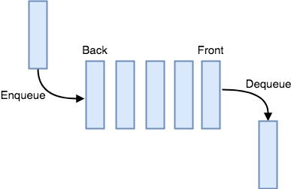
Enqueue and Dequeue
Adding an element to the FIFO queue is commonly referred to as an enqueue operation, while retrieving one from it is known as a dequeue operation

